Slide 1
Physical Education
9-12/Health
May 21, 2020

Slide 2
9-12 Health
Lesson: May 21,2020
Objective/Learning Target: Achieving Mental and Emotional Health
Chapter 15.3 Understanding Self Esteem
1. Distinguish between self-image and self-esteem.
2. Describe different types of self-esteem.
3. Identify factors that can affect a person’s self-esteem.
4. Summarize Maslow’s hierarchy of human needs.
5. Recognize characteristics of people who are achieving self-actualization.

Slide 4
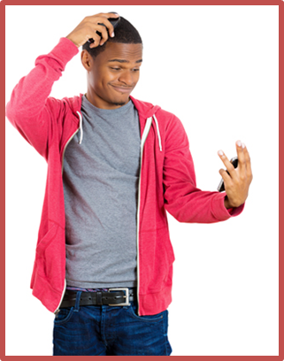
Self Image
•Your self-image is your mental picture of yourself
–Your appearance
–Your skills and abilities
–Your weaknesses
•Your self-image forms gradually over time
•It is influenced by your life experiences

Slide 5
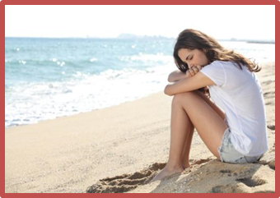
Self-Esteem
•Self-esteem describes how you feel about yourself
•People who like themselves have high
self-esteem
•People who have low
self-esteem doubt their own self-worth and may feel negatively about their traits, skills, and abilities

Slide 6
Why Self-Esteem Matters
•Your self-esteem has a major impact on different aspects of your life
–How well you do in school
–How easily you make friends
–How you manage disappointments and frustrations

Slide 7
Factors that Affect Self-Esteem
•Many factors can affect self-esteem
–Social interactions
–Home, school, community, and cultural environments
–Life events
–Media (books, movies, or social media)
–Body image
–Personal perceptions

Slide 8
Critical Thinking
Self-Esteem
What are some characteristics that people with high self-esteem have?
What are some characteristics that people with low self-esteem have?

Slide 9
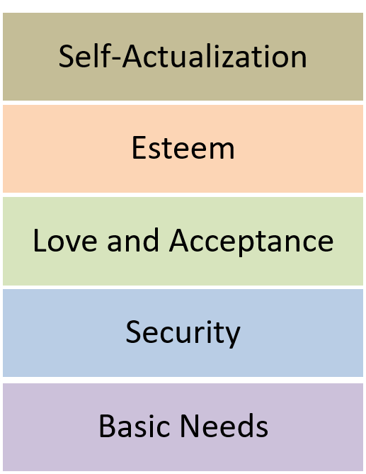
Self-Actualization
•Self-actualization is the feeling that you are becoming the best person you can be
•According to psychologist Abraham Maslow, self-actualization occurs only after you meet your basic needs

Slide 10
What are some characteristics that people who are achieving self-actualization share?
‒Accepting themselves and others for who they are
‒Feeling self-motivated
‒Working actively to solve problems
‒Viewing the world with a sense of appreciation
‒Enjoying spending time with other people as well as alone
‒Feeling at peace with themselves and the world

Slide 11
Moral Development
•Adolescents show changes in how they think about moral decisions
•By the time they reach high school, teenagers have typically formed their own moral code
•They can use this code to decide how to act in situations

Slide 12
Activity
15.3 Flash Cards
15.3 Matching

